Slide 1
Covid-19 Clock-In Application
Ryan Higgins, Daniel Gallagher, Shane McCormack, Jack McNamee
Advised by Joseph Corr

Slide 2
Table of Contents
Project Overview
Project Architecture
Prototype
Timeline

Slide 3
Project Overview
An application that allows employees to clock in via their smartphone to help prevent the transmission of Covid-19 in the workplace.
The employee will only be able to clock in when they are in the workplace and will have to use their front-facing camera to confirm their identify.
The clock in times will be recorded for the manager to view, thus removing the need for a physical clock-in system. This will be only be accessible to the manager who will have to also use their camera to confirm their identity thus protecting employee data.

Slide 4
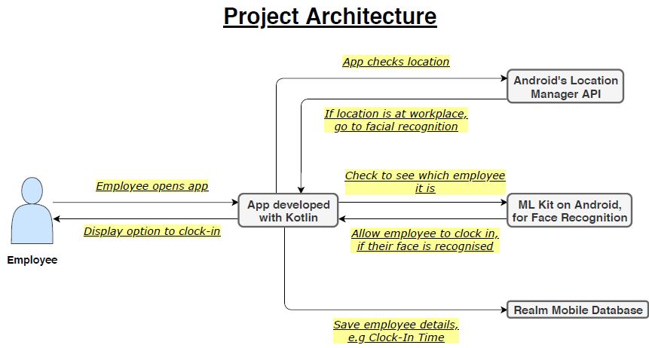
Project Architecture

Slide 5
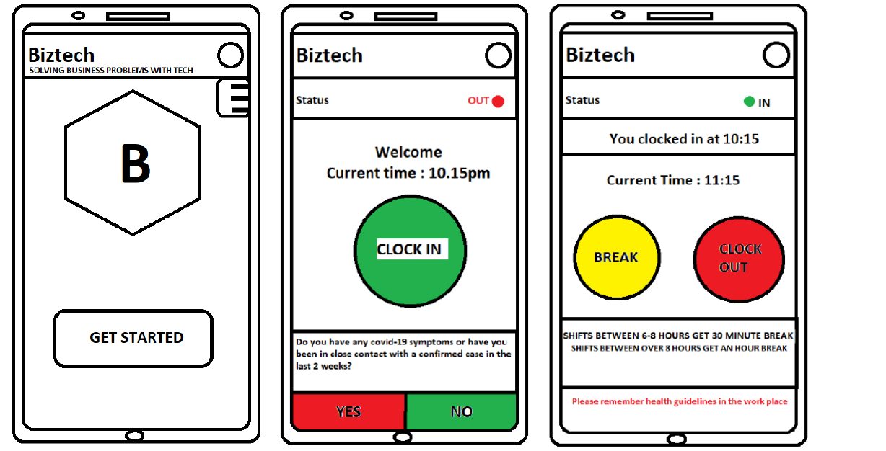
Our Prototype

Slide 6
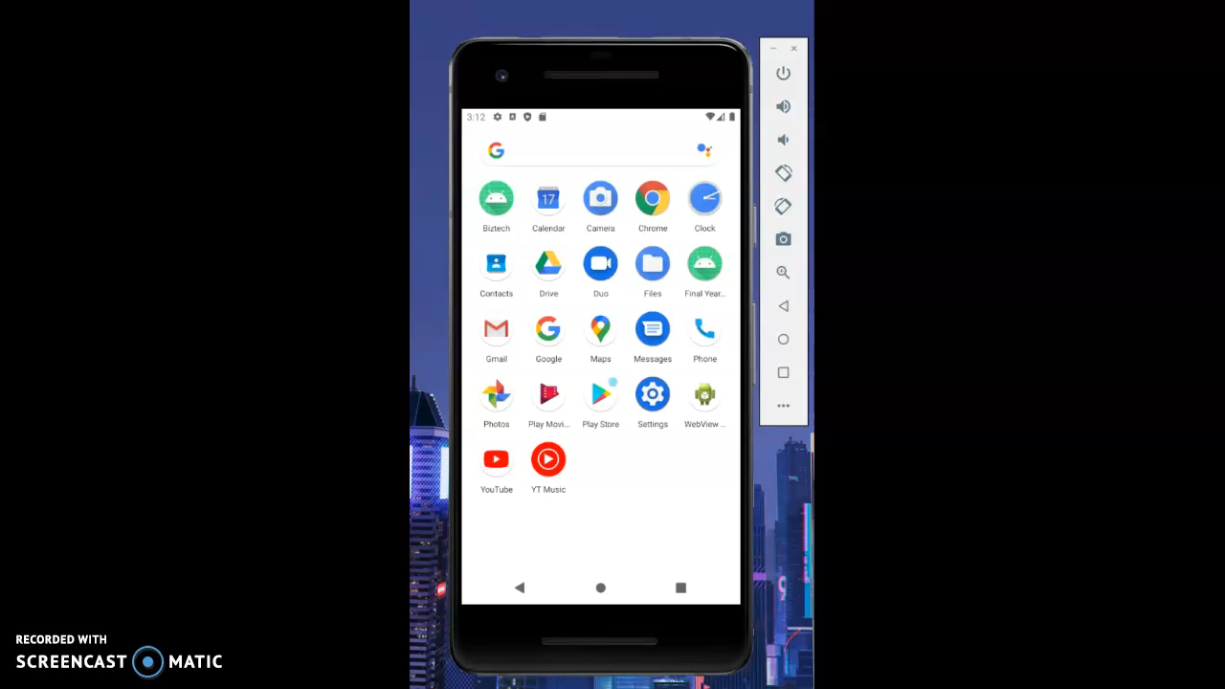
Our Prototype

Slide 7
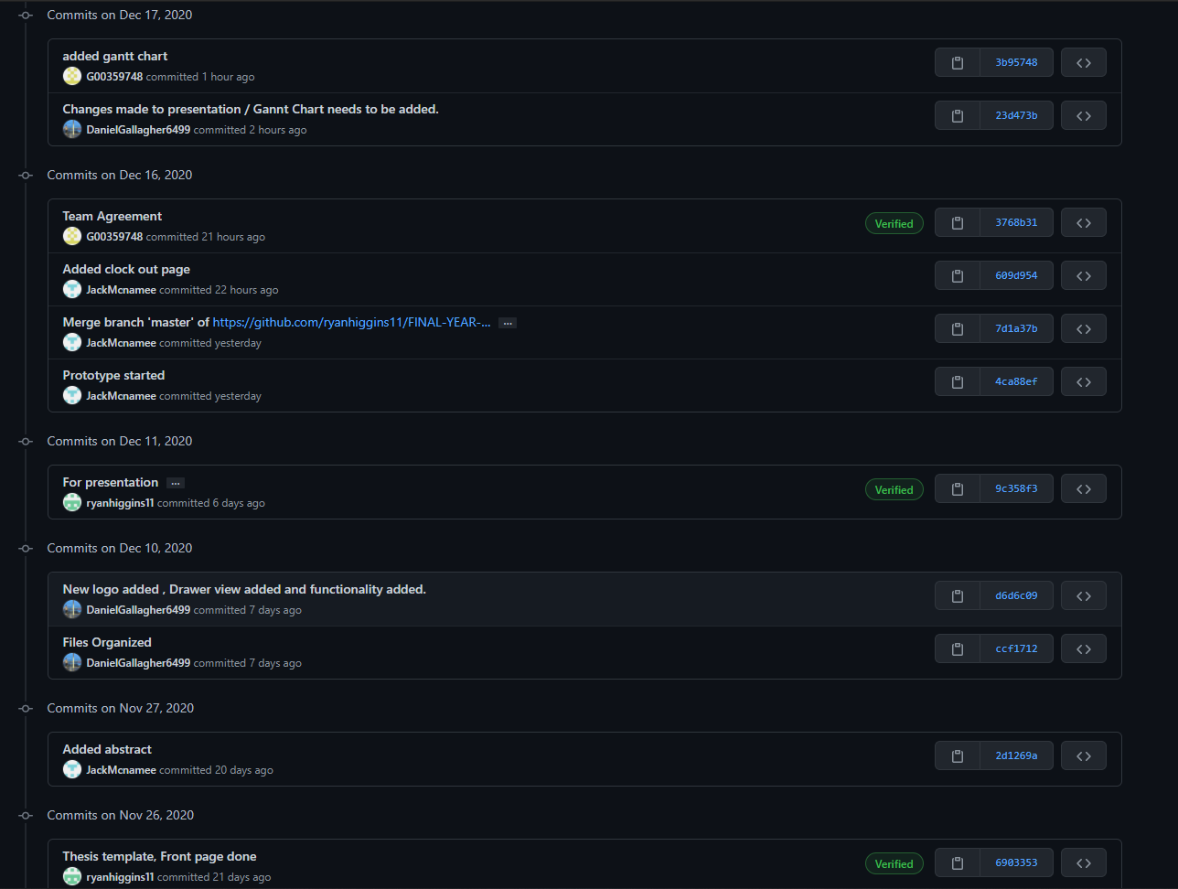
Git Commit History https://github.com/ryanhiggins11/FINAL-YEAR-PROJECT/commits/master

Slide 8
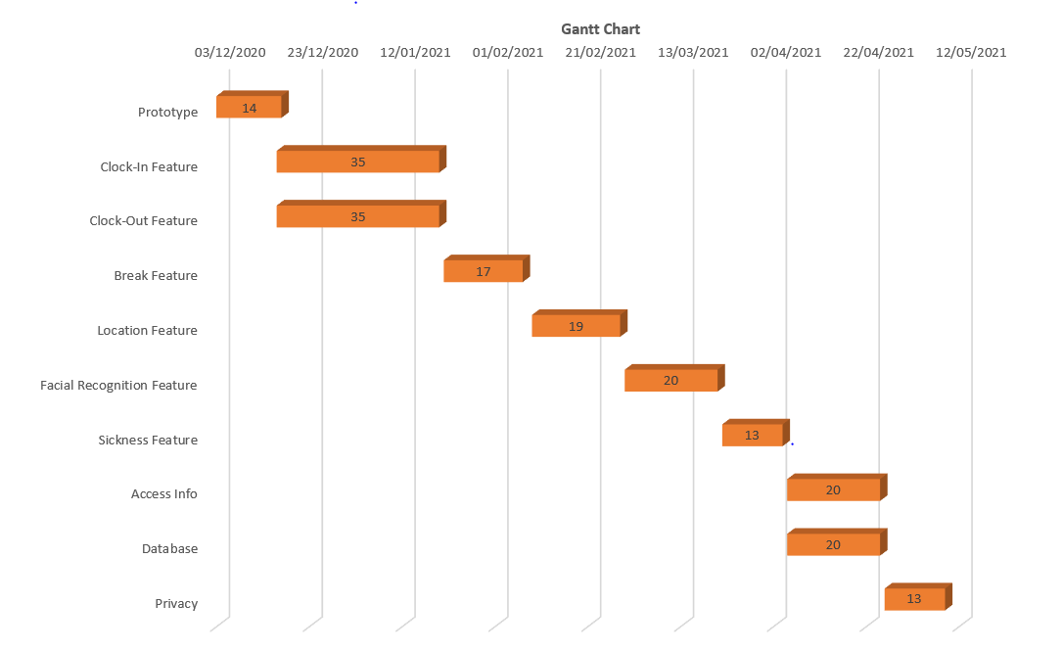
Timeline

